Slide 1
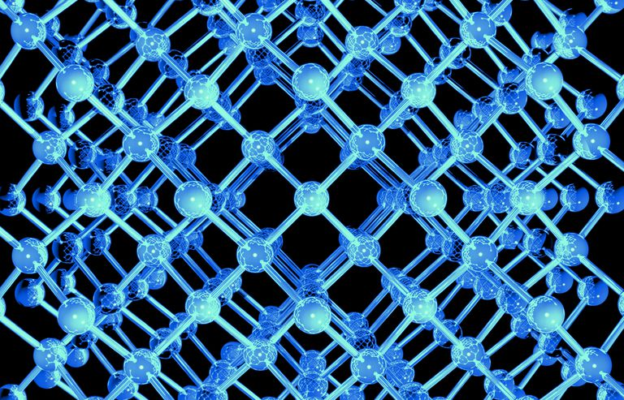
Ionic bonding
Properties and bonding model

Slide 2
Overview
General properties
Ionic bonding model
Properties explained using the bonding model
Uses

Slide 3
Ionic compounds - properties
General properties of ionic compounds:
  High melting and boiling points (all solids at room temperature)
  Hard but brittle and are therefore not malleable or ductile
  Do not conduct electricity in the solid state
  Are good conducts of electricity in the molten or aqueous state (dissolved in water)
  Varying solubility in water

Slide 4
Ionic compounds - properties
What do the general properties tell use about the structure?
  High melting and boiling points
  Hard but brittle
  Do not conduct electricity in the solid state
  Are good conducts of electricity in the molten or aqueous state
}
Forces are strong
In solid state there are no free moving charged particles (so no delocalized electrons and fixed ions)
In liquid state or solution there are charged particles that are free to move

Slide 5
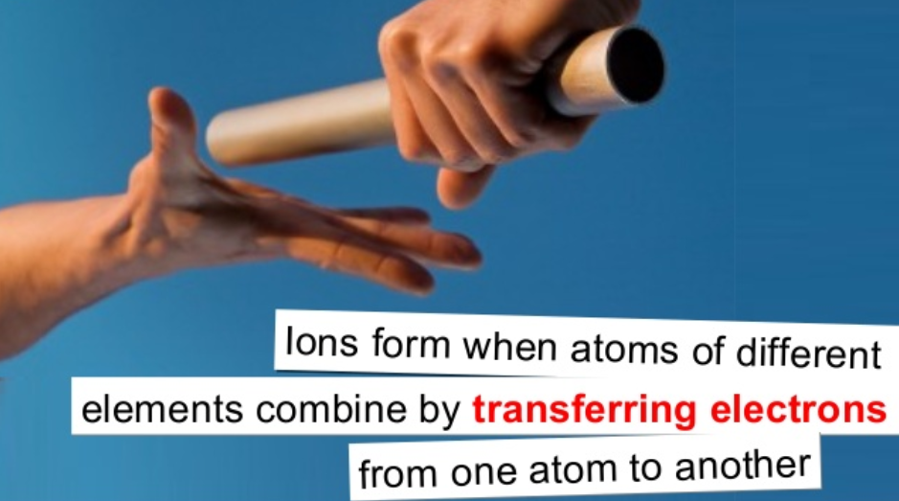

Slide 6
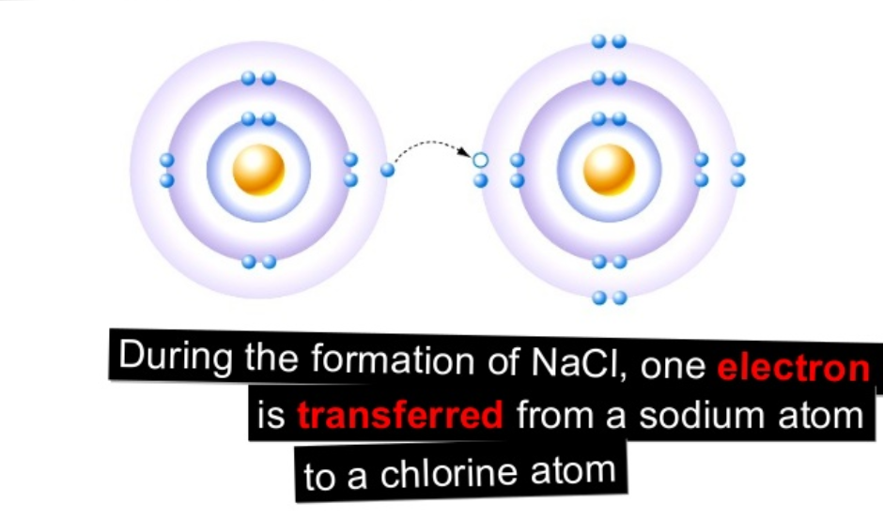

Slide 7
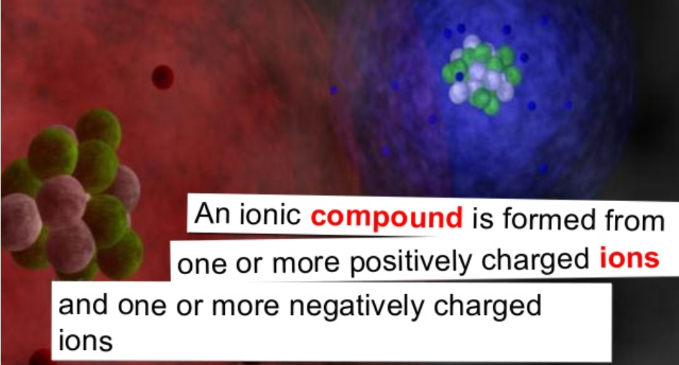

Slide 8
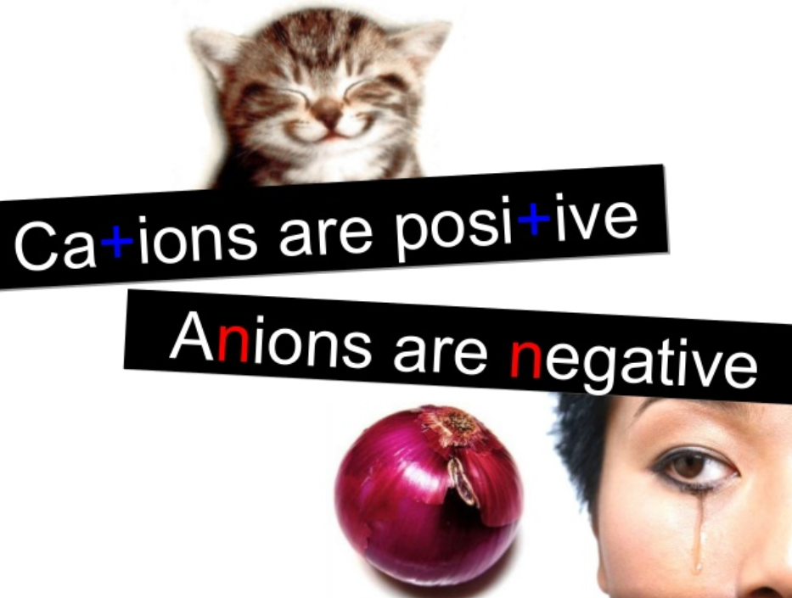

Slide 9
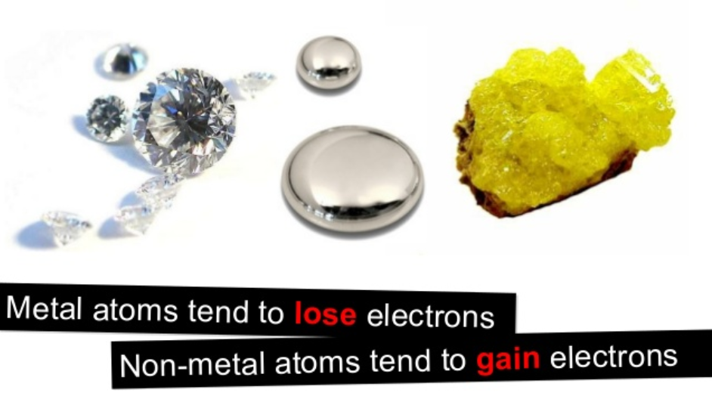
But why?

Slide 10
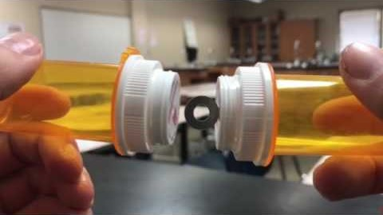
Consider this demonstration. Describe what is happening.

Slide 11
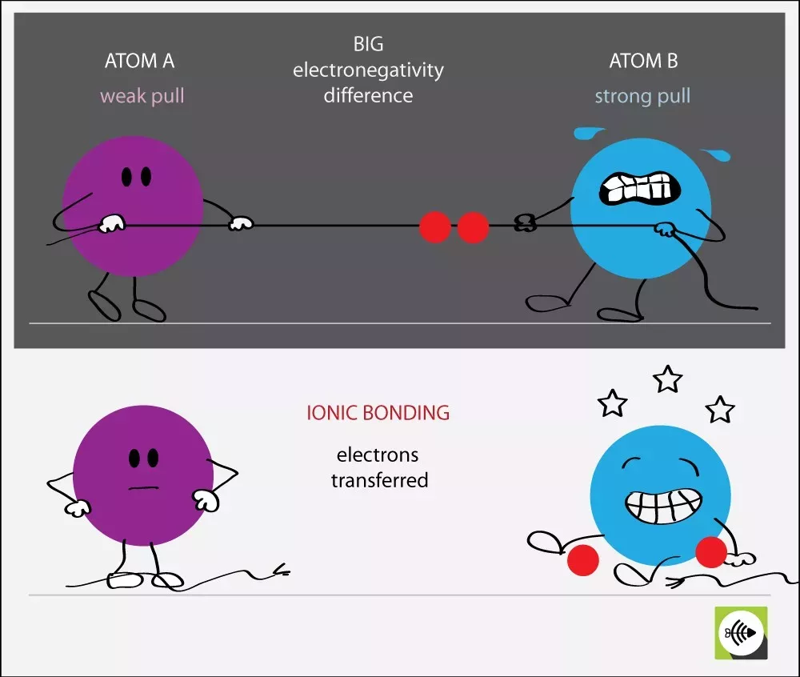

Slide 12
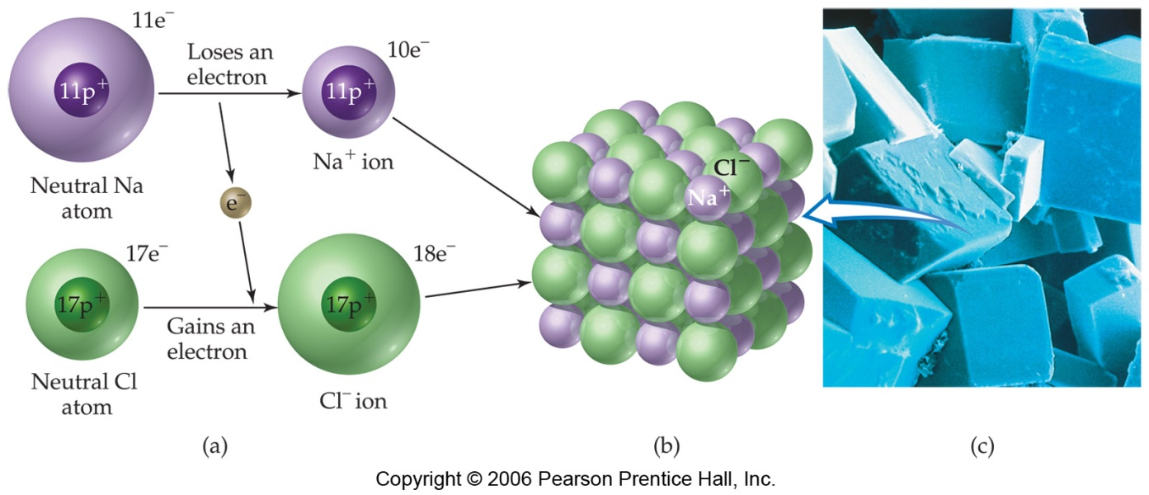
Ionic bonding model
To form an ionic compound one set of atoms, generally metals, have to lose electrons to form cations and another set of atoms, generally non-metals, have to gain electrons to form anions.
Both sodium and chloride now have a full valency – recall the Octet rule

Slide 13
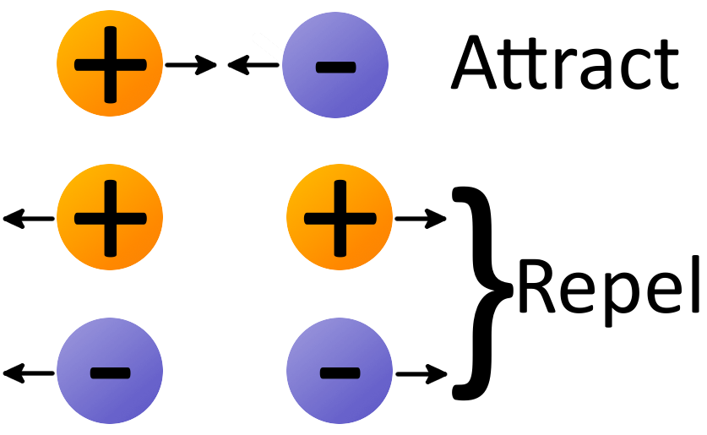
Ionic bonding model
After the electron transfer you have positive cations and negative anions
Forces at work – electrostatic attraction and repulsion
How do why order the ions to maximise attraction but minimise repulsion?

Slide 14
Ionic bonding model
the resulting cation and anion form a 3-dimensional ionic lattice
The like charges also repel each other, but this repulsion force is weaker as the like charges (e.g. positive and positive) are further apart – diagonal to each other in the lattice
The strong electrostatic attractions between cations and anions is called an Ionic bond

Slide 15
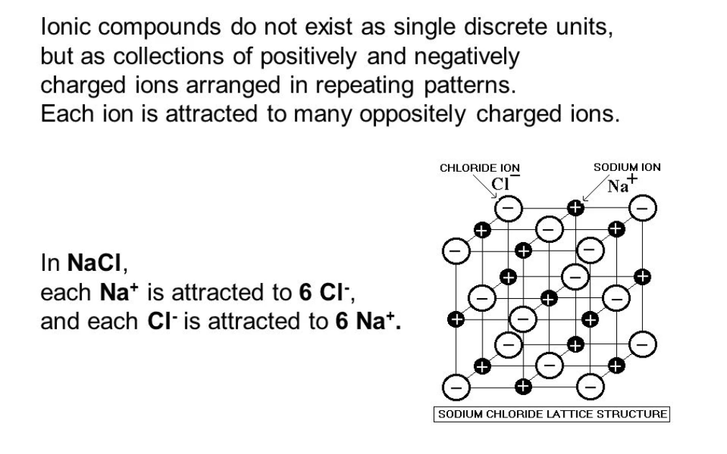
Ionic bonding model

Slide 16
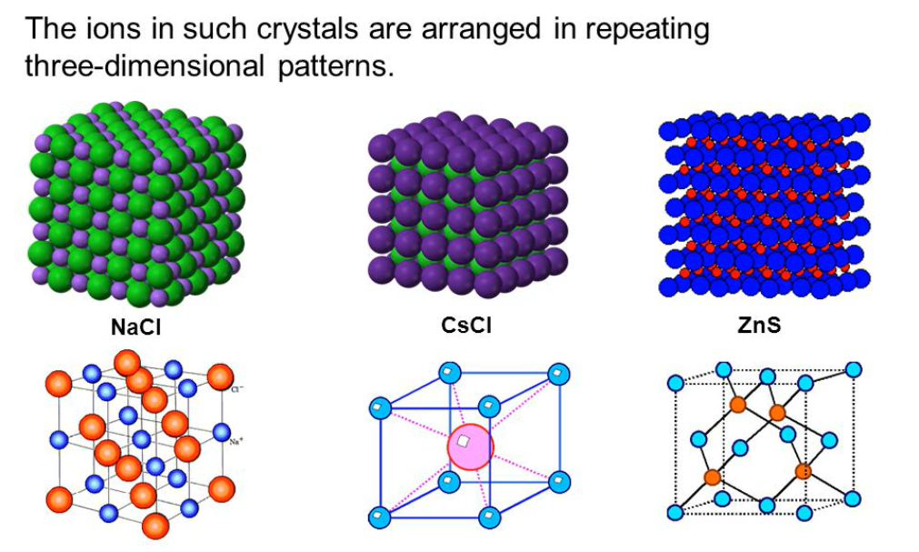
Different ions = different optimal packing

Slide 17
Ionic compounds - properties
General properties of ionic compounds:
  High melting and boiling points (all solids at room temperature)
  Hard but brittle and are therefore not malleable or ductile
  Do not conduct electricity in the solid state
  Are good conducts of electricity in the molten or aqueous state (dissolved in water)
  Varying solubility in water

Slide 18
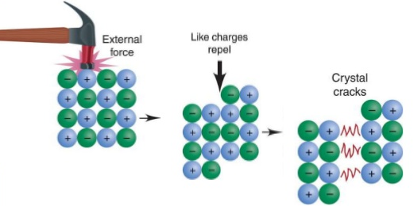
Hard and brittle
Ionic substances are generally hard and brittle
  Large force is required to cause the layers of ions to move
  This movement caused like charges to align closer to each other → like repels like
  Repulsion forces than dominate over attractive forces and the lattice breaks apart

Slide 19
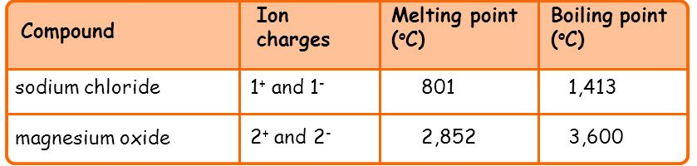
High melting and boiling point
Ionic substances have high melting and boiling points
  Ionic bonds are strong electrostatic attractive forces between ions
  These forces extend throughout the lattice, keeping the ions in fixed position
  A large amount of energy to disrupt the ionic lattice

Slide 20
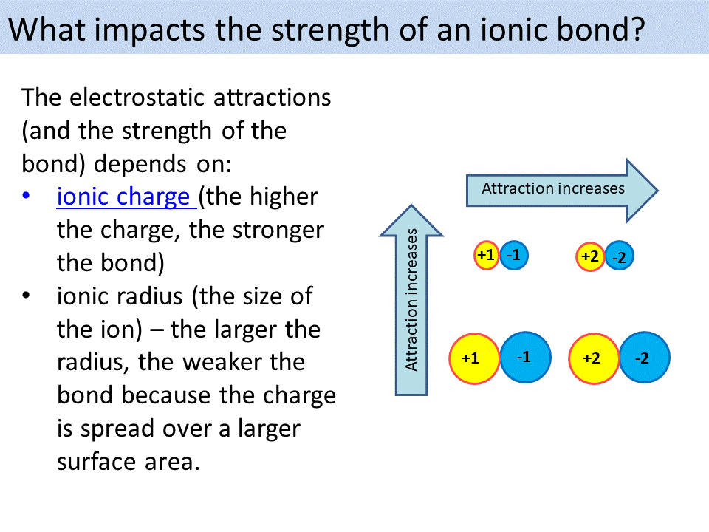
High melting and boiling point

Slide 21
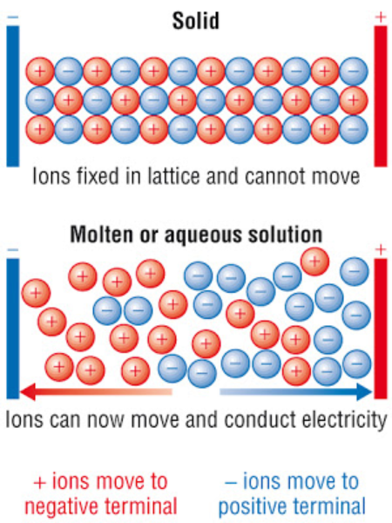
Electrical conductivity
Molten state → ions are free to move. Cations move towards the negative terminal and the anions towards to the positive terminal
Solid state → ions are in fixed positions. No moving charge = no electrical conductivity
Aqueous state → ions are free to move. Moving charge = able to conduct electricity

Slide 22
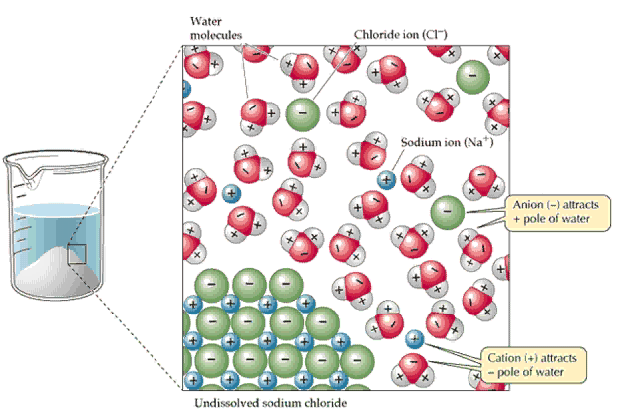
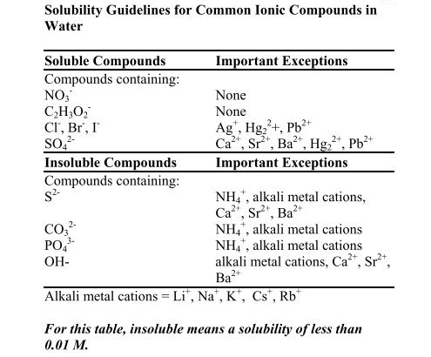
Solubility
Solubility of ionic compounds varies based on the nature of the ions involved. The solubility table in your data sheet provides information on the trends

Slide 23
Uses of ionic compounds
Hardness
  Calcium phosphate in bone
  Granite, limestone, sandstone used for building
  Bricks, tiles and other materials made of clay. Clay contains strong ionic bonding
Conductivity
  Ionic compounds are used in batteries, for example KOH is used in button batteries (its why they are so dangerous if swallowed)
Other uses
  Food (salt = NaCl, baking soda – sodium hydrogencarbonate); cleaning (bleach – sodium hypochlorite)

